Slide 1
Theorie Bioinformatica
Faster, better, stronger
Bioinformatics and functional genomics (3e) – Jonathan Pevsner (Wiley Blackwell)

Slide 2
De stof komt uit de college presentaties en Jonathan Pevsner "Bioinformatics and Functional Genomics"
(Wiley Blackwell; 3e editie) en een aantal extra papers
(deze worden expliciet in de betrokken colleges genoemd, en zijn te vinden onder "achtergrond").
College | Onderwerp | Hoofdstuk | Pagina's | Opmerkingen
1 | Recap Bioinf 1 | 3-4 | Zie Bioinf1 | Deze stof word t bekend verondersteld!
2 | Next Generation Sequencing | 9 | 377-423 | Niet de source code in je hoofd stampen!
3 | RNASeq | 11 | 479-515,519-528 | Niet de letterlijke R code, niet fig 11.17, 11.18, 11.19, 11.20
4 | Multiple Sequence Alignment | 6 | 205-217, 221-223 | Niet Box 6.3
8/9 | Assembly | 9/15 | 395-398,730-736 | Bestudeer ook de Powerpoint extra!
10 | The Burrough-Wheeler transform for mapping reads | 5
3 | Phylogeny | 7 | 245-289 | Niet Box 7.2,

Slide 3
Presentation content
Chapter 11: pg. 479-515, 519-528
http://pevsnerlab.kennedykrieger.org/php/powerpoints

Slide 4
Chapter 11:
Gene Expression: Microarray and RNA-seq Data Analysis

Slide 5
Chapter 11:
Gene Expression: Microarray
3 methods:
GEO2R
Partek Genomics Suite
R (affy and Limma)

Slide 6
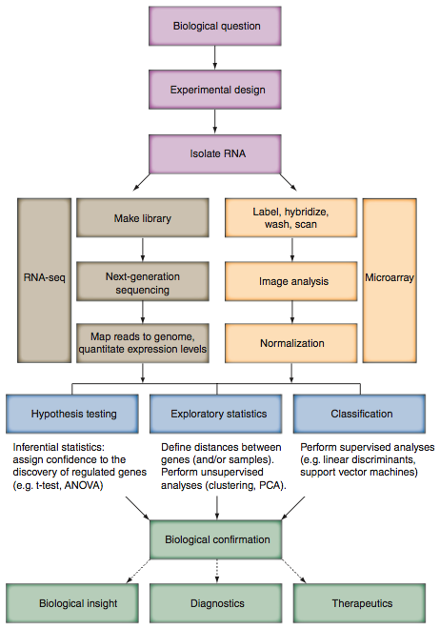
Workflow for assessing RNA changes (“gene expression”)

Slide 7
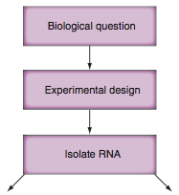
Workflow for assessing RNA changes (“gene expression”): Stage 1

Slide 8
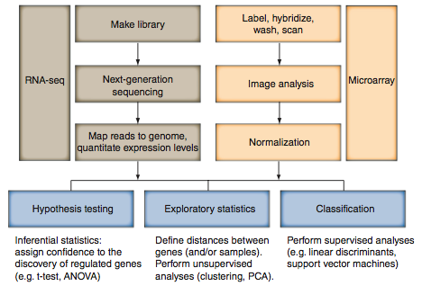
Workflow for assessing RNA changes (“gene expression”): Stage 2

Slide 9
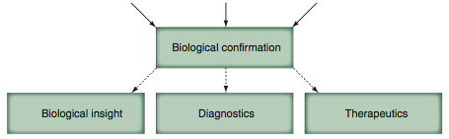
Workflow for assessing RNA changes (“gene expression”): Stage 3

Slide 10
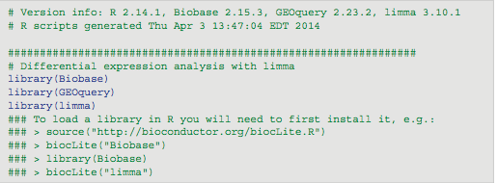
GEO2R executes a series of R scripts
We begin with GEO2R.
Simple, web-based tool available at NCBI
We’ll compare trisomy 21 and euploid samples
Although it’s simple to use, it uses R code that we’ll return to soon. This R code involves a steep learning curve, but you can look at via GEO2R.
Comments are indicated in lines with # and green font.

Slide 11
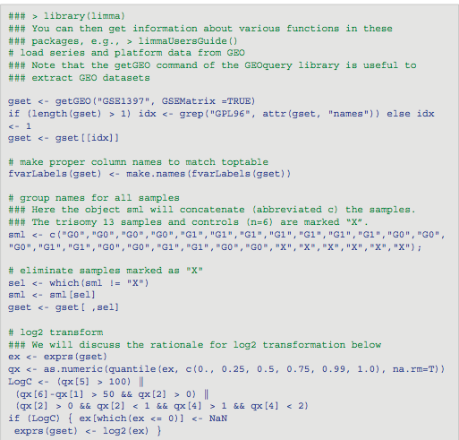
GEO2R executes a series of R scripts

Slide 12
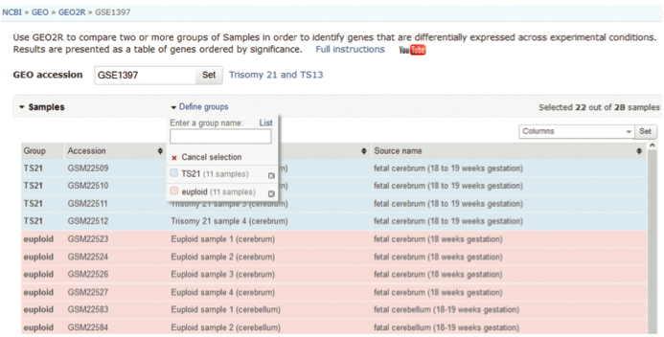
Analysis of GEO datasets using GEO2R at NCBI
We define two groups for analysis (TS21 for trisomy 21, euploid).
We tell GEO2R which samples belong in each group.

Slide 13
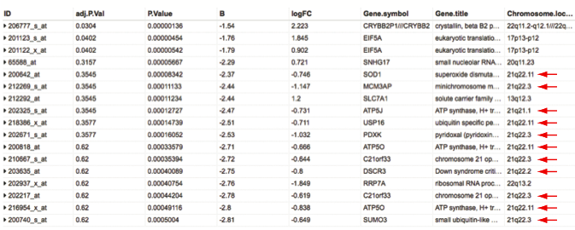
Analysis of GEO datasets using GEO2R at NCBI
With the click of a button we get results for differential expression analysis (based on the R package limma).
red arrows indicate up-regulated transcripts (in trisomy 21 samples) whose genes are assigned to chromosome 21

Slide 14
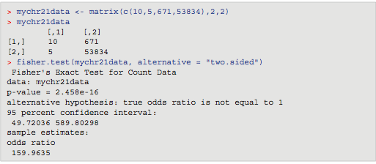
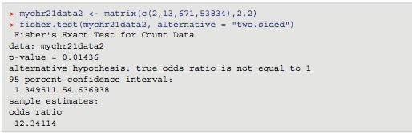
Using a Fisher’s Exact Test in R to decide if the GEO2R results (up-regulated transcripts on chromosome 21 genes) are significant
In R (or in RStudio) get help on how to run Fisher’s Exact Test by entering > ?fisher.test
The probability value (p-value) is very small; we can reject the null hypothesis.

Slide 15
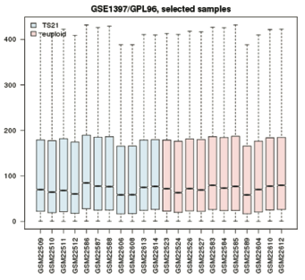
GEO2R results: boxplot of control, experimental samples
The boxplot indicates that the samples we chose to study have been normalized appropriately.

Slide 16
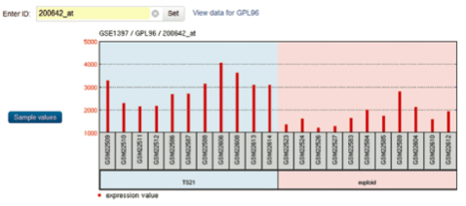
GEO2R results: boxplot of control, experimental samples
Example of a regulated transcript, SOD1 (derived from a chromosome 21 gene, expressed at a higher level in trisomy 21 cases than controls).
trisomy 21
euploid
Expression levels for SOD1

Slide 17
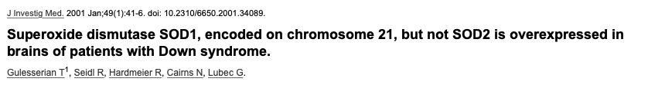
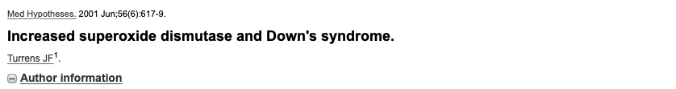
Conclusion: Increased SOD-1 levels in patients with DS may reflect the overexpression by the trisomic state, as a response to the oxidative stress, as has been proposed in DS by several authors. However, it well may be that glial proliferation, which is markedly increased in DS brain, may underlie the increased brain levels of this ubiquitous protein. The decrease of SOD1 in the temporal cortex of patients with AD may reflect an antiapoptotic mechanism or simply cell loss in the brain.
Conclusion: We also propose that the increased SOD may be, instead, responsible for the increased incidence of
Down's syndrome in children of older women. The augmented antioxidant protection resulting from
an extra copy of chromosome 21 may, with time, selectively protect human oocytes from apoptosis,
increasing their proportion with age, explaining the higher incidence of this disease.

Slide 18
Robust multi-array analysis (RMA)
Developed by Rafael Irizarry, Terry Speed, others
Available at www.bioconductor.org as an R package
There are three steps:
[1] Background adjustment based on a normal plus exponential model (no mismatch data are used)
[2] Quantile normalization (nonparametric fitting of signal intensity data to normalize their distribution)
[3] Fitting a log scale additive model robustly. The model is additive: probe effect + sample effect

Slide 19
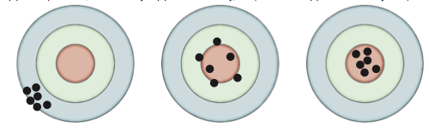
Accuracy and precision
Good precision, low accuracy
Good accuracy, low precision
Good accuracy and precision

Slide 20
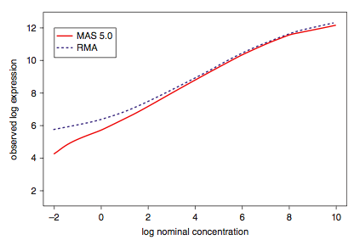
Improvements in accuracy and precision using RMA
Accuracy is measured by plotting known concentrations of RNA (x axis) versus observed concentrations (y axis).

Slide 21
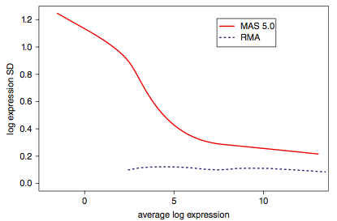
Improvements in accuracy and precision using RMA
Precision is measured by plotting the average log expression value (x axis) versus the log expression standard deviation (y axis).

Slide 22
Fold change (log ratios)
To a statistician fold change is sometimes considered meaningless. Fold change can be large (e.g. >>two-fold up- or down-regulation) without being statistically significant (e.g. based on probability values from a t-test or ANOVA).
To a biologist fold change is almost always considered important for two reasons. First, a very small but statistically significant fold change might not be relevant to a cell’s function. Second, it is of interest to know which genes are most dramatically regulated, as these are often thought to reflect changes in biologically meaningful transcripts and/or pathways.

Slide 23
Analysis of GEO datasets using GEO2R at NCBI
With the click of a button we get results for differential expression analysis (based on the R package limma).
red arrows indicate up-regulated transcripts (in trisomy 21 samples) whose genes are assigned to chromosome 21

Slide 24
Inferential statistics
Inferential statistics are used to make inferences
about a population from a sample.
Hypothesis testing is a common form of inferential
statistics. A null hypothesis is stated, such as:
“There is no difference in signal intensity for the gene
expression measurements in normal and diseased
samples.” The alternative hypothesis is that there
is a difference.
We use a test statistic to decide whether to accept or
reject the null hypothesis. For many applications,
we set the significance level a to p < 0.05.

Slide 25
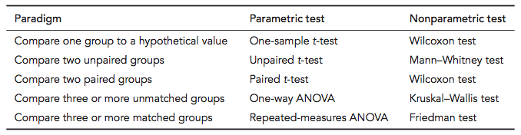
Test statistics for gene expression data

Slide 26
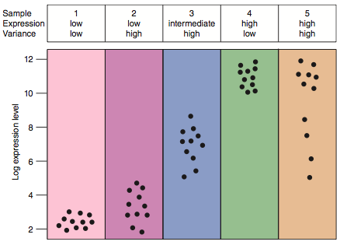
Transcript-specific variance is addressed by a t-test
Each dot is a replicate. Comparison of conditions 3 and 4 would produce a significant difference (we reject the null). Comparison of 4 versus 5 might not.

Slide 27
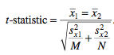
t-test: assess differences between two groups
Consider two groups for which you obtain measurements.
Set a null hypothesis that there is no difference in the means of these two groups.
Set an alternate hypothesis that there is a difference.
In the numerator take the absolute value of the difference of the two group means.
In the denominator calculate the noise.
From the t-statistic obtain a probability value.

Slide 28
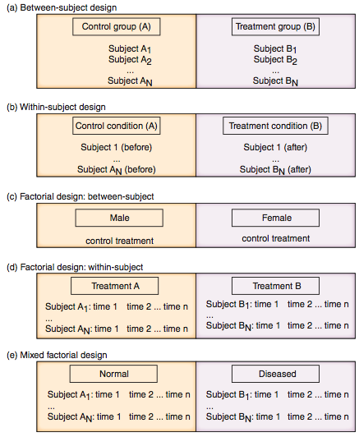
Experimental design for gene expression profiling

Slide 29
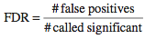
Inferential statistics: false discovery rate
The false discovery rate (FDR) is a popular multiple corrections correction. A false positive (also called a type I error) is sometimes called a false discovery.
The FDR equals the p-value of the t-test times the number of genes measured (e.g. for 10,000 genes and a p-value of 0.01, there are 100 expected false positives).
You can adjust the false discovery rate. For example:
FDR # regulated transcripts # false discoveries
0.1 100 10
0.05 45 3
0.01 20 1
Would you report 100 regulated transcripts of which 10 are likely to be false positives, or 20 transcripts of which one is likely to be a false positive?

Slide 30
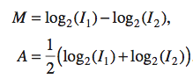
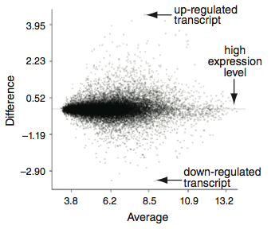
Summarizing your experiment: MA plot
An MA plot shows expression levels (x-axis) for measured data points and up- and down-regulation for individual transcripts (y-axis).

Slide 31
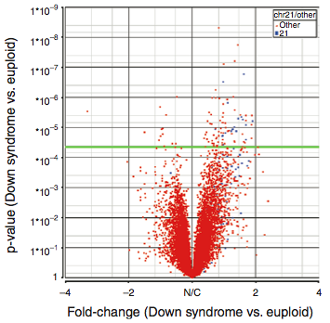
Volcano plot: significantly regulated genes vs. fold change
A volcano plot shows fold change (x-axis) versus p value from ANOVA (y-axis). Each point is the expression level of a transcript. Points high up on the y-axis (above the pale green horizontal line) are significantly regulated.

Slide 32
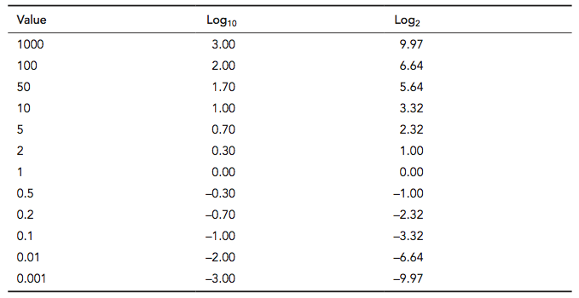
Log₂ and log₁₀ values
Expression values are routinely transformed into log base 2 space. For a comparison of a sample to a control the log₂ ratio is 0. Two-fold up-regulation has a log2 value of +1.0, while two-fold down-regulation has a value of -1.0.

Slide 33
Principal components analysis (PCA)
An exploratory technique used to reduce the
dimensionality of the data set to 2D or 3D
For a matrix of m genes x n samples, create a new
covariance matrix of size n x n
Thus transform some large number of variables into
a smaller number of uncorrelated variables called
principal components (PCs).

Slide 34
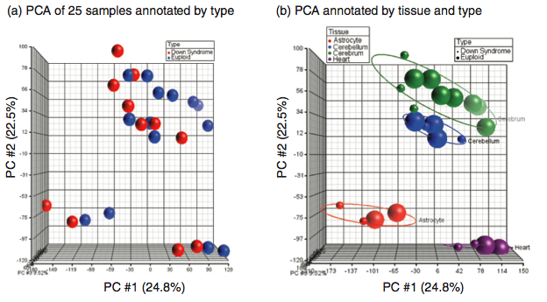
Partek for gene expression analysis: PCA plot
Here a principal components analysis (PCA) plot shows n=25 data points (one for each sample). These points are annotated by disease diagnosis (left)

Slide 35
Partek for gene expression analysis: PCA plot
cerebrum
cerebellum
heart
astrocyte
Here a principal components analysis (PCA) plot shows n=25 data points (one for each sample). These points are annotated by disease diagnosis (left) or tissue type (right).

Slide 36
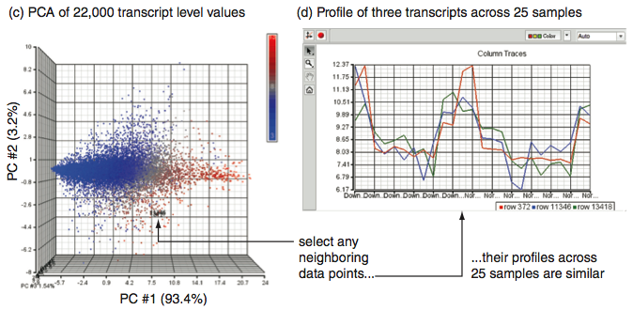
Partek for gene expression analysis: PCA plot
PCA can be performed on rows or columns of any matrix. Here individual expression points are plotted (left). Select a few points and examine their profile across all 25 samples (right). The fact that they have similar expression patterns explains why they are adjacent in PCA space.

Slide 37
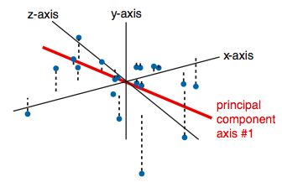
Principal components analysis
The first principal component (PC) follows a “best fit” through the data points. Other PCs must cross the origin of the plot, and must be orthogonal.

Slide 38
Principal components analysis (PCA): objectives
• to reduce dimensionality
• to determine the linear combination of variables
• to choose the most useful variables (features)
• to visualize multidimensional data
• to identify groups of objects (e.g. genes/samples)
• to identify outliers

Slide 39
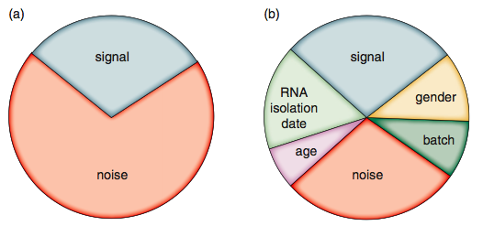
ANOVA can partition the data, boosting the signal to noise ratio
A t-test (left) allows you to detect signal in the context of some noise. ANOVA (right) further partitions the noise by accounting for factors such as age, batch, and date.

Slide 40
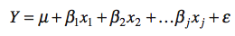
ANOVA
The ANOVA identifies differentially expressed genes while accounting for variance that occurs both within groups and between groups. ANOVA is particularly appropriate when an experiment has multiple classes of treatment (e.g., control samples are compared to two different disease states or to five different time points) or multiple factors for each treatment (e.g., gender, age, date of RNA isolation, hybridization batch).
ANOVA is a statistical model called a general linear model. It takes the form:
where Y is a linear function of X with slope β and intercept μ, and x₁, x₂, ..., x_{j} is a series of independent variables; ε is an error term.

Slide 41
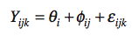
ANOVA
For expression data a commonly used model is:
Y_{ijk} represents a pre-processed probe intensity measurement k (in the log2 scale) of transcript i measured by platform j
if there are 20,000 transcripts represented on a microarray, there will be that many Y_{ijk} values
The terms φ and θ are independent variables associated with expression measurement and probe effects.
θ_{i} is the absolute gene expression value in the log2 scale
φ_{ij} is a platform-specific probe effect
ε_{ijk} represents a term for measurement error (residual, unexplained variance).

Slide 42
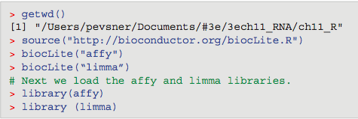
Gene expression analysis using R (affy and limma)
There are over 1,000 R packages available in BioConductor, including many useful for microarrays or RNA-seq. Begin by obtaining R and RStudio. You can then install packages and load them.

Slide 43
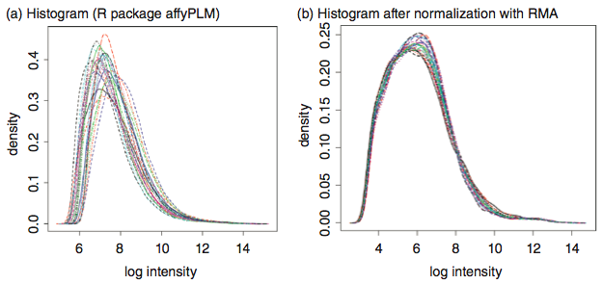
Histograms of expression data in R
Before (left) and after (right) normalization.

Slide 44
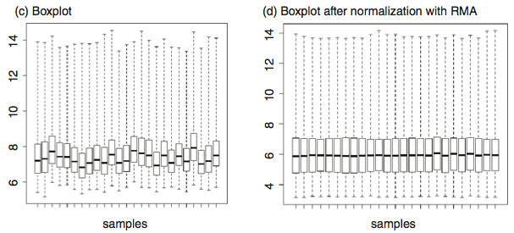
Boxplots of expression data in R
Before (left) and after (right) normalization.

Slide 45
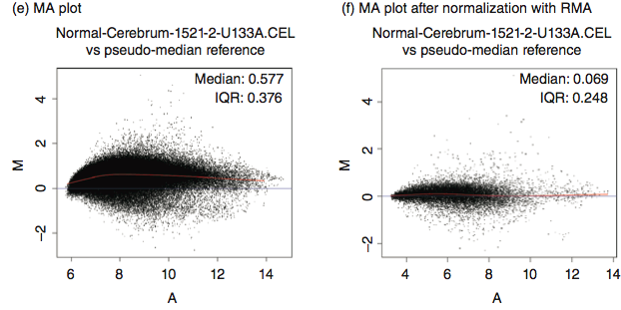
MA plots of expression data in R
Before (left) and after (right) normalization.

Slide 46
Descriptive statistics
Microarray data are highly dimensional: there are
many thousands of measurements made from a small
number of samples.
Descriptive (exploratory) statistics help you to find
meaningful patterns in the data.
A first step is to arrange the data in a matrix.
Next, use a distance metric to define the relatedness
of the different data points. Two commonly used
distance metrics are:
-- Euclidean distance
-- Pearson coefficient of correlation

Slide 47
Descriptive statistics: clustering
Clustering algorithms offer useful visual descriptions
of microarray data.
Genes may be clustered, or samples, or both.
We will next describe hierarchical clustering.
This may be agglomerative (building up the branches
of a tree, beginning with the two most closely related
objects) or divisive (building the tree by finding the
most dissimilar objects first).
In each case, we end up with a tree having branches
and nodes.

Slide 48
Agglomerative clustering
0
1
2
3
4
a
a,b
b
c
d
e
Adapted from Kaufman and Rousseeuw (1990)

Slide 49
Agglomerative clustering
0
1
2
3
4
a
a,b
b
c
d
d,e
e

Slide 50
Agglomerative clustering
0
1
2
3
4
a
a,b
b
c
c,d,e
d
d,e
e

Slide 51
Agglomerative clustering
0
1
2
3
4
a
a,b
b
a,b,c,d,e
c
c,d,e
d
d,e
e
…tree is constructed

Slide 52
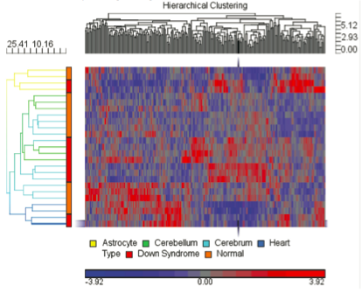
Hierarchical clustering of 250 chromosome 21 transcripts
in 25 samples using Partek software
Hierarchical clustering of microarray data using the default settings of Euclidean dissimilarity for rows (samples) and columns (transcripts). Colors correspond to expression intensity values.

Slide 53


RNA-sequencing
RNA-seq is used to accomplish the same goal as microarrays: quantifying RNA transcript levels.

Slide 54
Sequencing strategies: RNA-seq
RNA-seq / cDNA sequencing is done to get insight into
gene expression levels
different allele expression
alternative splicing
(alternative) transcription start sites (deepCAGE)
(alternative) polyA site mapping (deepSAGE)
Translation start site identification (Ribosome Profiling / RPF)
(anti)sense expression
Etc

Slide 55
Techniques for expression profiling
A few genes
Northern blot
Quantitative RT-PCR
Genome-wide
Microarrays
RNA-seq
miRNA-seq

Slide 56
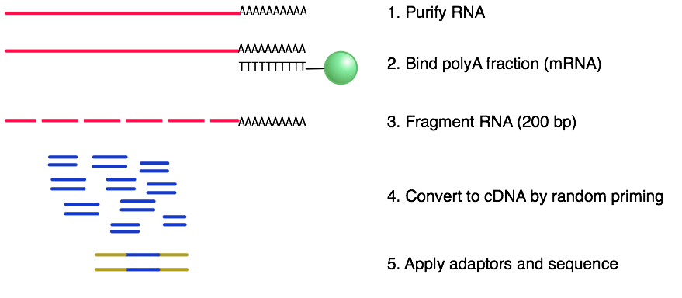
RNA-seq (Illumina)
Geospiza.com, edited

Slide 57
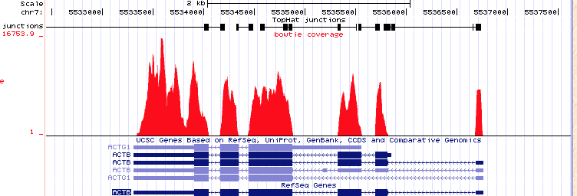
Example of RNA-seq (Illumina)
Geospiza.com, edited

Slide 58
RNA-seq
RNA-seq is used to accomplish the same goal as microarrays: quantifying RNA transcript levels. However, it is considered revolutionary because
it allows the measurement of essentially all RNA transcripts (rather than only those pre-selected on a microarray surface),
it has a broader dynamic range,
it allows identification of novel transcripts and transcript isoforms, and
it is able to quantify alternative splicing events.

Slide 59
Workflow for RNA-seq data analysis

Slide 60
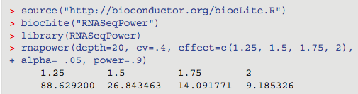
Workflow for RNA-seq data analysis: stage 1
Be sure to select an adequate sample size. Here is a sample power calculation in R:

Slide 61
Workflow for RNA-seq data analysis: stage 2

Slide 62
Workflow for RNA-seq data analysis: stage 3

Slide 63
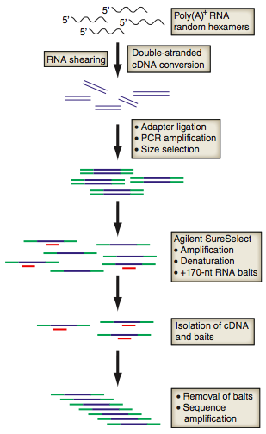
Method for targeted RNA-seq: stage 1

Slide 64
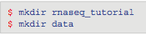
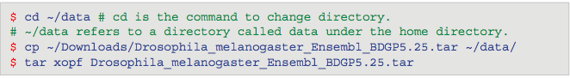
RNA-seq data analysis: example using TopHat, CuffLinks
We next perform RNA-seq data analysis following a tutorial published by Trapnell et al. (2013). This provides a detailed protocol. Begin by creating directories you’ll need.
Download and unpack a Drosophila data set.

Slide 65
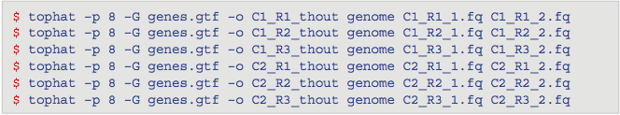
RNA-seq data analysis: example using TopHat, CuffLinks
Use Tophat, a fast splice junction mapper for RNA-seq data.
Specify
the number of processors (-p 8)
the reference genome (-G genes.gtf)
the output file names (e.g. -o C1_R1_thout) where thout is TopHat output; and
the input fastq files (here C1 and C2 are condition 1 and condition 2; R1-R2 are replicates 1-3; *_1.fq and _2.fq refer to forward and reverse reads).

Slide 66

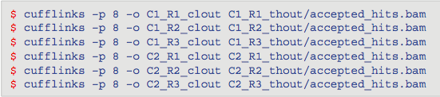
RNA-seq data analysis: example using TopHat, CuffLinks
A series of BAM files is produced, representing aligned reads. Assess the quality:
Use CuffLinks to assemble transcripts:

Slide 67
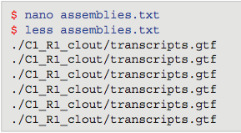
RNA-seq data analysis: example using TopHat, CuffLinks
Create a text file, assemblies.txt.
Run Cuffmerge on all the assemblies. This generates a single merged transcriptome annotation.

Slide 68
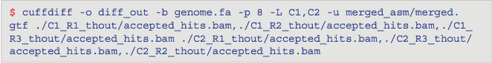
RNA-seq data analysis: example using TopHat, CuffLinks
Use Cuffdiff to identify differentially expressed genes and transcripts. We use the merged transcriptome assembly and the BAM files from TopHat.

Slide 69
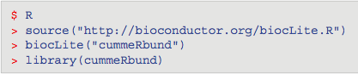
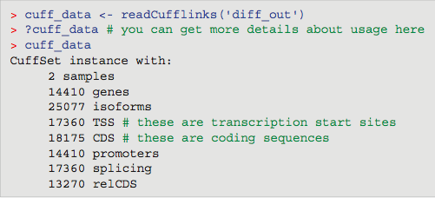
RNA-seq data analysis: example using TopHat, CuffLinks
Next use the R package cummeRbund to visualize our results.
Take the CuffDiff output and create a cummeRbund database called cuff_data. Before we make plots, let’s look at the database and explore the transcripts that are most regulated based on p-value and based on fold change.

Slide 70
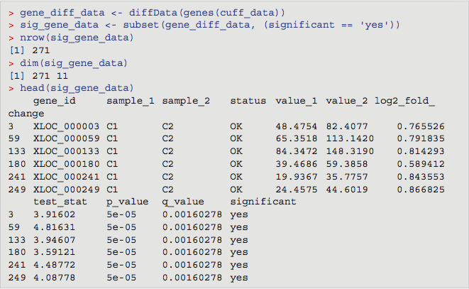
RNA-seq data analysis: example using TopHat, CuffLinks
Create the file gene_diff_data using the diffData function, and then select the subset of significantly regulated transcripts. We see the number of rows (271), the dimensions (271 × 11 columns), and the first few values.

Slide 71

RNA-seq data analysis: example using TopHat, CuffLinks
Which transcript is up-regulated the most? We can take the sig_gene_data table and sort it by the column log2_fold_change.

Slide 72



Visualizing RNA-seq data with the R package cummeRbund
Plot the data:
distribution of intensity values
Scatter plot

Slide 73



Visualizing RNA-seq data with the R package cummeRbund
Volcano plot
Bar plots of expression values

Slide 74
RGASP: RNA-seq genome annotation assessment project
RGASP was designed to evaluate computational methods to predict and quantify expressed transcripts from RNA-seq data.
Developers of 14 software programs analyzed RNA-seq data to assess methods for exon identification, transcript reconstruction, and expression-level quantification (Steijger et al., 2013).
Performance was lower for Homo sapiens data than for Drosophila or C. elegans.
Identifying all exons cannot be accomplished.
Valid assembly of exons into transcript isoforms was accomplished for just 41% of human genes.
Methods vary substantially in their estimates of expression levels from the same gene loci.

Slide 75
Functional annotation of microarray data
Expression data are commonly annotated with Gene Ontology data (Chapter 12). Pathway analyses are performed with tools such as Ingenuity Pathway Analysis (IPA) and Gene Set Enrichment Analysis (GSEA).

Slide 76
Functional annotation of microarray data
GSEA examines predefined groups, such as those genes defined as relevant to heart development or transcription. GSEA tests whether the set of genes in each of those groups are randomly distributed among all 20,000 measurements (null hypothesis) or not (alternate hypothesis).

Slide 77
GSEA:
1) calculates an enrichment score;
2) estimates significance with a permutation test (the class labels are permuted randomly as part of the null model, and the enrichment score from scrambled labels is calculated 1000 times);
3) performs a multiple test correction. The false discovery rate is the estimated probability that a gene set with some enrichment score is a false positive result.
Functional annotation of microarray data

Slide 78
Perspective
DNA microarray technology, introduced in the late 1990s, allows the experimenter to rapidly and quantitatively measure the expression levels of thousands of genes in a biological sample.
RNA-seq emerged a decade later. It offers tremendous advantages in detecting and quantitating splice isoforms, discovering new transcribed regions, and offering a wider dynamic range from transcripts expressed at low to high levels. There are also great computational challenges in analyzing RNA-seq data.

